Slide 1
Data Communication and
Networks
S.Sathya Priya

Slide 2
Network Layer
Addressing and Routing

Slide 3
Introduction
NL is responsible for the source-to-destination delivery of a packet, possibly across multiple networks (links).
DLL is responsible for the delivery of the packet between two systems on the same network (links).
NL ensures that each packet gets from its point of origin to its final destination.
NL in the Internet, is a packet-switched network that uses connectionless communication.

Slide 4
Introduction(contd..)

Slide 5
Needs for logical addressing
Computer needs to communicate with another computer somewhere else in the world.
Usually, computers communicate through the Internet.
The packet transmitted by the sending computer may pass through several LANs or WANs before reaching the destination computer.
For this level of communication, need a global addressing scheme; - logical addressing.
the term IP address to mean a logical address in the network layer of the TCP/IP protocol suite.

Slide 6
Addressing
At the NL, need to uniquely identify each device on the Internet to allow global communication between all devices.
The NL adds a header that includes the logical addresses of the sender and receiver to the packet corning from the upper layer.
It is roughly equivalent to telephone system.
Each telephone subscriber has a unique number, given that the country code and the area code.

Slide 7
Internet Address(IPv4 ADDRESSES)
To identify each device connected to the Internet is called the Internet Address or IP address.
32-bit binary address the uniquely and universally defines the connection of a host or router to the Internet.
IP addresses are unique.
IP address does not actually refer to a host.
It really refers to a network interface.
There are 2 common notations to IP address: binary notation and dotted-decimal notation.

Slide 8
Address Space
IPv4 that defines addresses has an address space.
address space is the total number of addresses used by the protocol.
IPv4 uses 32-bit addresses, which means that the address space is 2³² or 4,294,967,296 (more than 4 billion).
This means that, theoretically, if there were no restrictions, more than 4 billion devices could be connected to the Internet.

Slide 9
Notations
Two notations for an IPv4 address:
        binary notation
        dotted-decimal notation.

Slide 10
Binary Notation
In binary notation, the IP address is displayed as 32 bits.
Each octet is often referred to as a byte.
To make the address more readable, one or more space is inserted between each octet (8 bits).
01110101 10010101 00011101 11101010

Slide 11
Dotted-Decimal Notation
IP address more compact and easier to read
usually written in decimal form with a decimal point (dot) separating the bytes.
128.11.3.31

Slide 12
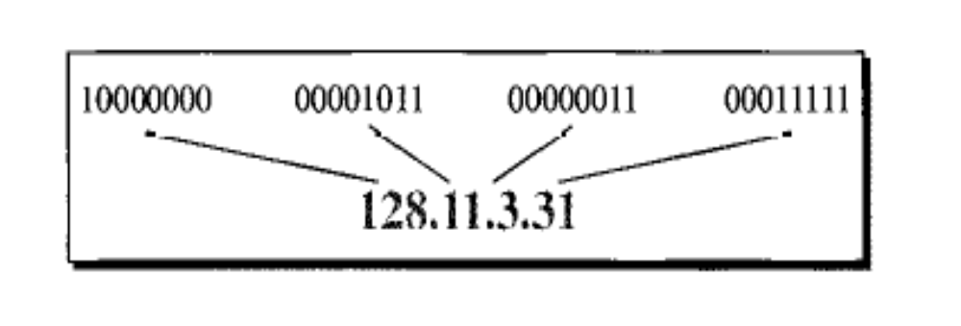
Dotted Decimal and Binary Notation of IPv4 Address

Slide 13
Classful Addressing
classful addressing, the address space is divided into 5 classes: A, B, C, D, E.
The address space is divided into five classes: A, B, C, D, and E
If the address is given in binary notation, the first few bits can immediately tell us the class of the address
If the address is given in decimal-dotted notation, the first byte defines the class
Network numbers are managed by a nonprofit corporation called ICANN (Internet Corporation for Assigned Names and Numbers) to avoid conflicts.

Slide 14
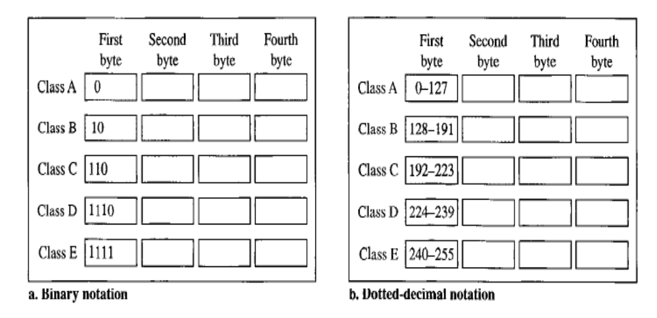
IPv4 Classes in Binary and Dotted Decimal notations

Slide 15
Netid and Hostid
IP address in classes A,B,C, is divided into netid and hostid
Varying lengths, depending on the class of the address.
Class A, 1 byte defines the netid.
Class B, 2 bytes defines the netid.
Class C, 3 bytes defines the netid.

Slide 16
Classes and Blocks
One problem with classful addressing is that each class is divided into a fixed number of blocks with each block having a fixed size.
Each class is divided into a fixed number of blocks with each block having a fixed size
Class A addresses were designed for large organizations with a large number of attached hosts or routers
Class B addresses were designed for midsize organizations with tens of thousands of attached hosts or routers
Class C addresses were designed for small organizations with a small number of attached hosts or routers
Class D addresses were designed for multicasting
Class E addresses were reserved for future use

Slide 17
Class A
Class A is divided into 128 blocks with each block having a different netid.
First block covers addresses from 0.0.0.0 to 0.255.255.255 (netid 0).
Second block covers addresses from 1.0.0.0 to 1.255.255.255 (netid 1).
First address in the block is used to identify the organization to the rest of the Internet. This address is called the network address.
It defines the network of the organization, not individual hosts.
Number of addresses in each block 16,777,216.

Slide 18
Class B
Class B is divided into 16,384 blocks with each block having a different netid.
16 blocks are reserved for private addresses, leaving 16,368 blocks for organizations.
First block covers addresses from 128.0.0.0 to 128.0.255.255 (netid 128.0).
Second block covers addresses from 129.1.0.0 to 129.1.255.255 (netid 129.0).
Last block covers addresses from 191.255.0.0 to 191.255.255.255 (netid 191.255).
Number of addresses in each block 65,536.

Slide 19
Class C
Divided into 2097,152 blocks with each blocks having different netid.
256 blocks are used for private purposes.
Each block contains 256 addresses.

Slide 20
Class D
One block of class D addresses. It is designed for multicasting.
Class E
One block of class E addresses. It is designed for use as reserved addresses.

Slide 21
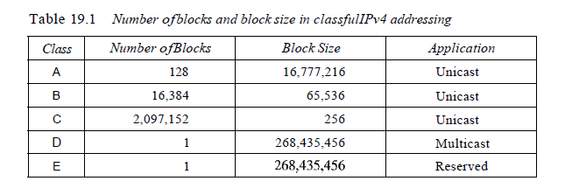

Slide 22
Network address
It is an address that defines the network itself; it cannot be assigned to a host.
Network address plays a very important role in classful addressing.
Network address has several properties.
  All hosted bytes are 0s.
  The network address defines the network to the rest of the Internet. Later, we learn that, router can route the packet based on the network address.
  Network address is the first address in the block.
  Given the network address, we can find the class.

Slide 23
Mask
Although the length of the netid and hostid (in bits) is predetermined in classful addressing, we can also use a mask (also called the default mask).
a 32-bit number made of contiguous 1s followed by contiguous 0s.
The masks for classes A, B, and C and does not apply to classes D and E.

Slide 24
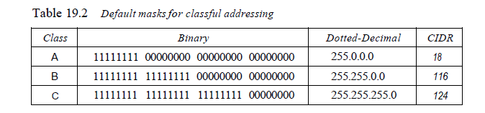
mask for a class A address has eight 1s, which means the first 8 bits of any address in class A define the netid; the next 24 bits define the hostid.
The last column of Table shows the mask in the form In where n can be 8, 16, or 24 in classful addressing.
This notation is also called slash notation or Classless Interdomain Routing (CIDR) notation.
The notation is used in classless addressing. We introduce it here because it can also be applied to classful addressing.

Slide 25
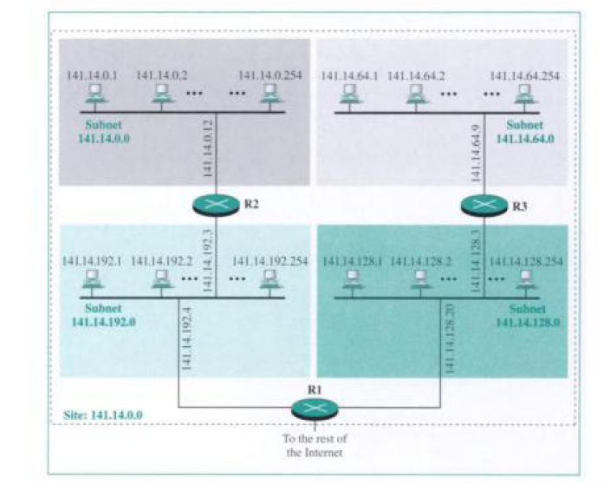
Subnetting
divide the addresses into several contiguous groups and assign each group to smaller networks.
Subnetting increases the number of 1s in the mask

Slide 26
Subnetting
divide the addresses into several contiguous groups and assign each group to smaller networks.
Subnetting increases the number of 1s in the mask

Slide 27
Supernetting
Supernetting was introduced when class A and class B addresses were depleted and class C block did not satisfy the needs of most organizations
In supernetting, an organization can combine several class C blocks to create a larger range of addresses
Supernetting decreases the number of 1s in the mask so that the mask changes from /24 to /22.
Classless addressing eliminated the need for supernetting.

Slide 28
Classless Addressing
In classless addressing, it is granted a block (range) of addresses.
The size of the block (the number of addresses) varies based on the nature and size of the entity
To simplify the handling of addresses, the Internet authorities impose three restrictions on classless address blocks:
The addresses in a block must be contiguous, one after another.
The number of addresses in a block must be a power of 2 ie (1, 2, 4,8,)
The first address must be evenly divisible by the number of addresses

Slide 29
Mask
In classless addressing the mask for a block can take any value from 0 to 32
They are represeanted as slash n or “/n”
The address and the /n notation completely define the whole block (the first address, the last address, and the number of addresses).
The first address in the block can be found by setting the rightmost 32 - n bits to 0s.
The last address in the block can be found by setting the rightmost 32 - n bits to 1s.

Slide 30
Example:
A block of addresses is granted to a small organization. We know that one of the addresses is 205.16.37.39/28. What is the first address in the block?
Solution
binary representation of the given address is 11001101 00010000 00100101 00100111.
If we Set 32 - 28 rightmost bits to 0, we get 11001101 00010000 00100101 00100000 or 205.16.37.32.
The first address in the block can be found by setting the rightmost 32 - n bits to 0s. So 205.16.37.32 is the first address.
The last address in the block can be found by setting the rightmost 32 - n bits to 1s. So 205.16.37.47 is the last address.

Slide 31
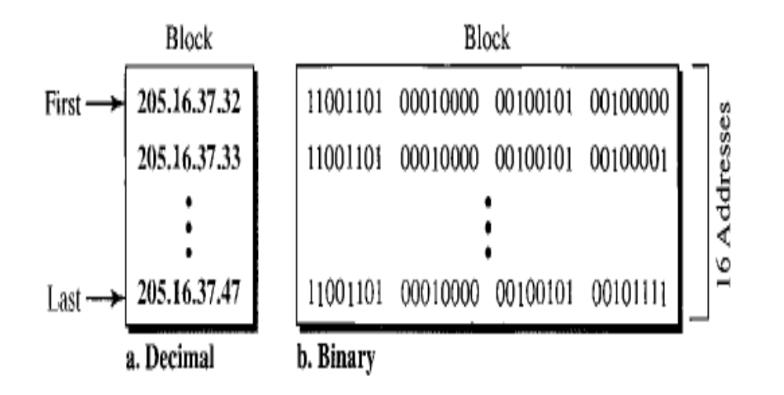
The first address and last address

Slide 32
Network Addresses
first address is called the network address and defines the organization network.
First address is the one that is used by routers to direct the message sent to the organization from the outside

Slide 33
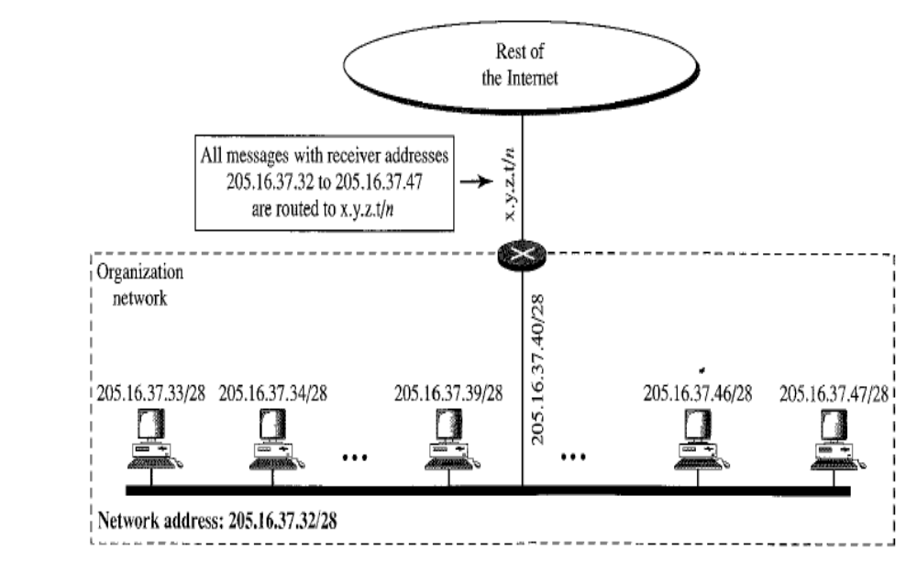
A network configuration for the block 205.16.37.32/28

Slide 34
Hierarchy
IP addresses are designed in different levels of hierarchy.
Two-Level Hierarchy: No Subnetting
define only two levels of hierarchy when not subnetted
The n leftmost bits of the address x.y.z.t/n define the network, the 32 – n rightmost bits define the particular host to the network
The part of the address that defines the network is called the prefix; the part that defines the host is called the suffix

Slide 35
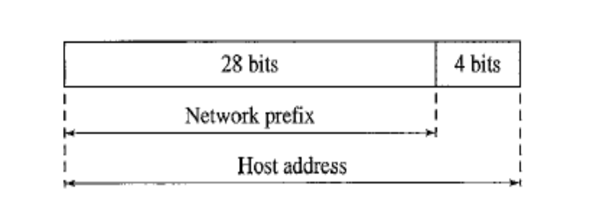
Two levels of hierarchy in an IPv4 address

Slide 36
Three-Levels of Hierarchy: Subnetting
Large block of addresses may want to create clusters of networks (called subnets)
divide the addresses between the different subnets
All messages are sent to the router address that connects the organization to the rest of the Internet; the router routes the message to the appropriate subnets.
The organization has its own mask; each subnet must also have its own.

Slide 37
Example:
Suppose an organization is given the block 17.12.40.0/26, which contains 64 addresses. The organization has three offices and needs to divide the addresses into three subblocks of 32, 16, and 16 addresses.
We can find the new masks by using the following arguments:
1. Suppose the mask for the first subnet is n1, then 2³²- n1 must be 32, which means that n1 =27.
2. Suppose the mask for the second subnet is n2, then 2³²- n2 must be 16, which means that n2 = 28.
3. Suppose the mask for the third subnet is n3, then 2³²- n3 must be 16, which means that n3 =28.
This means that we have the masks 27, 28, 28 with the organization mask being 26.

Slide 38
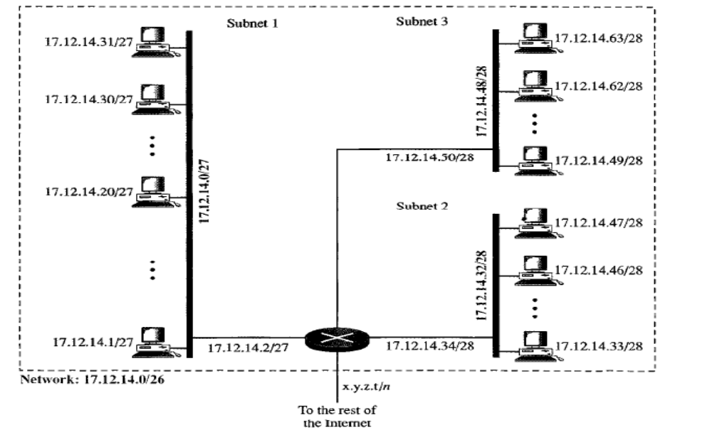
Configuration and addresses in a subnetted network

Slide 39
Network Address Translation (NAT)
NAT is a used when there is shortage of address because of the following scenarios
  Home users and small businesses can be connected by an ADSL line or cable modem.
  Many are not happy with one address; many have created small networks with several hosts and need an IP address for each host.
NAT enables a user to have a large set of addresses internally and one address, or a small set of addresses, externally.
The site must have only one single connection to the global Internet through a router that runs the NAT software.

Slide 40
Internet authorities have reserved three sets of addresses as private addresses
    10.0.0.0 to 10.255.255.255 2²⁴
    172.16.0.0 to 172.31.255.255 2²⁰
    192.168.0.0 to 192.168.255.255 2¹⁶
unique inside the organization, but they are not unique globally.
No router will forward a packet that has one of these addresses as the destination address.
The site must have only one single connection to the global Internet through a router that runs the NAT software.

Slide 41
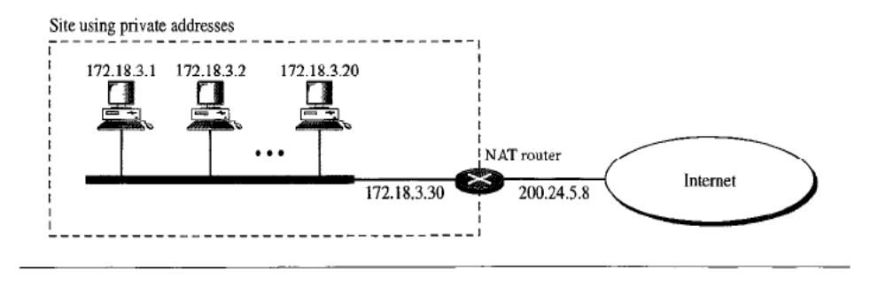
NAT Implementation
The router that connects the network to the global address uses one private address and one global address.
The private network is transparent to the rest of the Internet; the rest of the
Internet sees only the NAT router with the address 200.24.5.8.

Slide 42
Address Translation
All the outgoing packets go through the NAT router, which replaces the source address in the packet with the global NAT address
All incoming packets also pass through the NAT router, which replaces the destination address in the packet (the NAT router global address) with the appropriate private address.

Slide 43
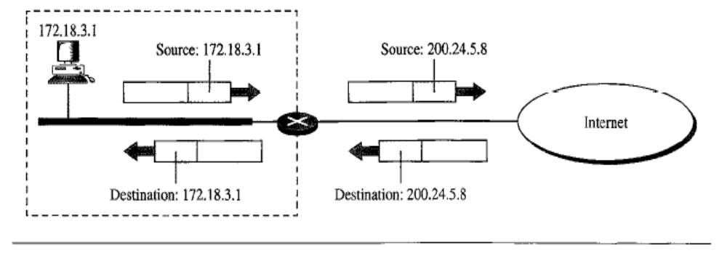
Addresses in NAT

Slide 44
Translation Table
NAT router has a translation table which directs the incoming packets from internet to the destination address.
A translation table has only two columns: the private address and the external address
It works as given below:
  Translates the source address of the outgoing packet and note down the destination address
  When the response comes back from the destination, the router uses the source address of the packet to find the private address of the packet

Slide 45
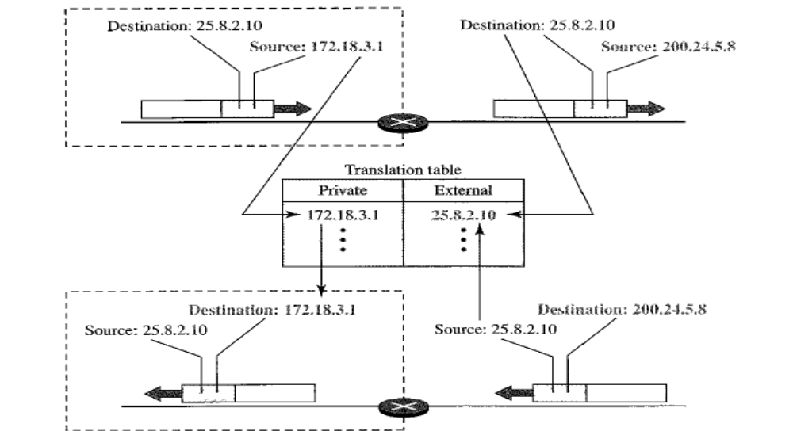
NAT address translation

Slide 46
Translation Table…..(Continued)
NAT is used mostly by ISPs which assign one single address to a customer.
A private network cannot run a server program for clients outside of its network if it is using NAT technology

Slide 47
Using a Pool of IP Addresses
The NAT router has only one global address, only one private network host can access the same external host
To solve this Pool of IP Address is used.
For example, instead of using only one global address (200.24.5.8), the NAT router can use four addresses (200.24.5.8, 200.24.5.9, 200.24.5.10, and 200.24.5.11)
Four private network hosts can communicate with the same external host at the same time because each pair of addresses defines a connection.

Slide 48
Using a Pool of IP Addresses
They suffer some draw backs too:
  No more than four connections can be made to the same destination
  No private-network host can access two external server programs (e.g., HTTP and FTP) at the same time

Slide 49
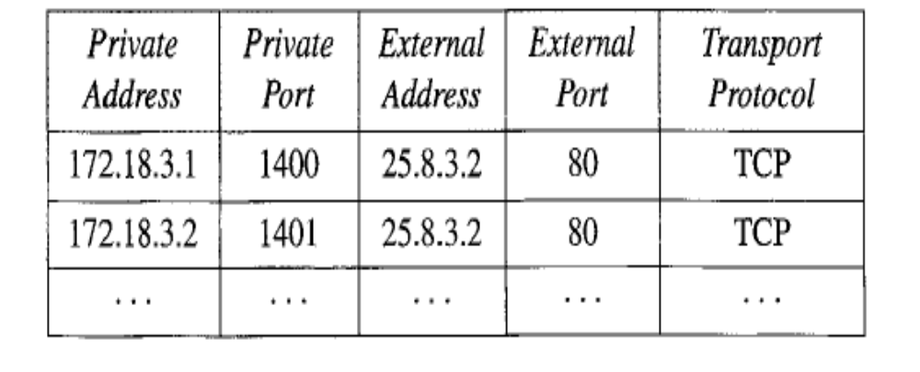
Using Both IP Addresses and Port Numbers
To allow a many-to-many relationship between private-network hosts and external server programs, we need more information in translation table
If we include the source and destination port numbers of the transport layer protocol, the ambiguity is eliminated.
Fig: An Example of Translation table with IP Addresses and Port Numbers

Slide 50
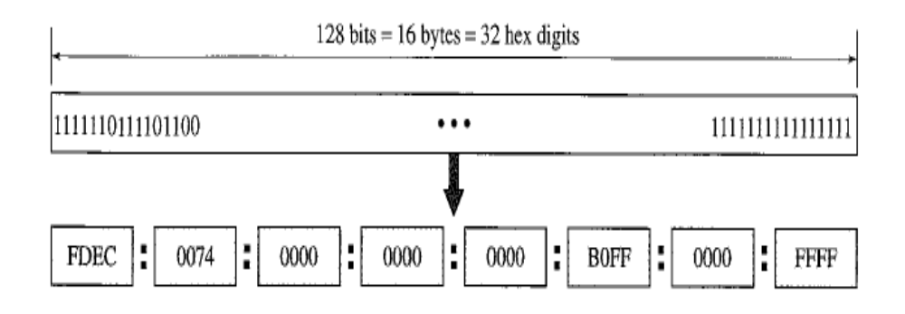
IPv6 ADDRESSES
An IPv6 address is 128 bits long.
Hexadecimal Colon Notation
IPv6 specifies hexadecimal colon notation. In this notation, 128 bits is divided into eight sections, each 2 bytes in length.
Two bytes in hexadecimal notation requires four hexadecimal digits.
The address consists of 32 hexadecimal digits, with every four digits separated by a colon

Slide 51
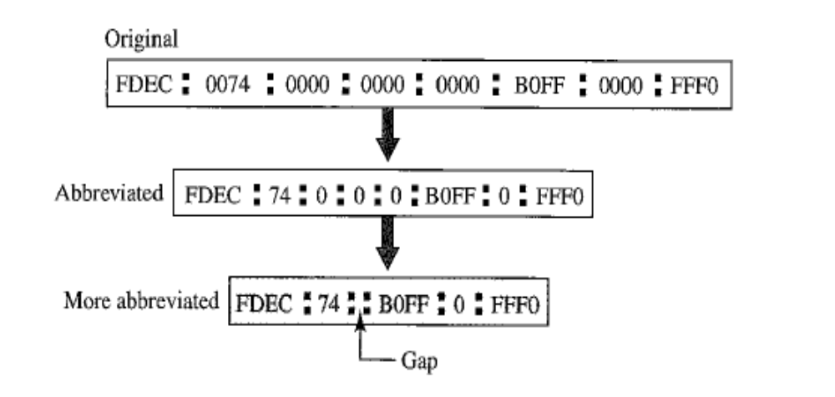
Abbreviation
Even in hexadecimal format, IPv6 addresses are very long, so abbreviations are used
Only the leading zeros can be dropped, not the trailing zeros
Abbreviated IPv6 addressing

Slide 52
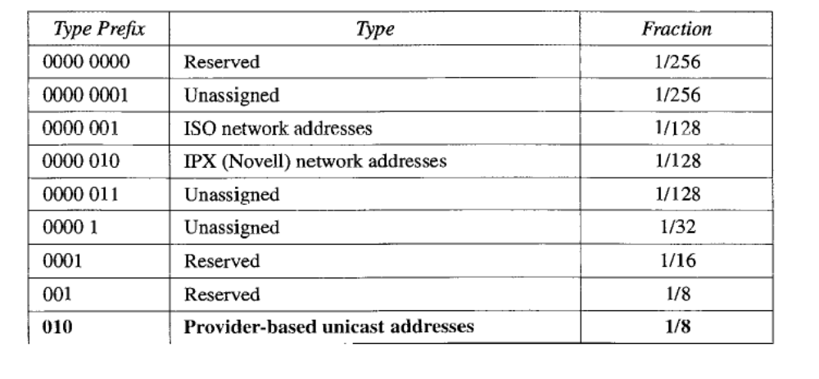
Address Space
IPv6 has a much larger address space; 2¹²⁸ addresses are available
IPv6 divided the address into several categories. A few leftmost bits, called the type prefix, in each address define its category

Slide 53
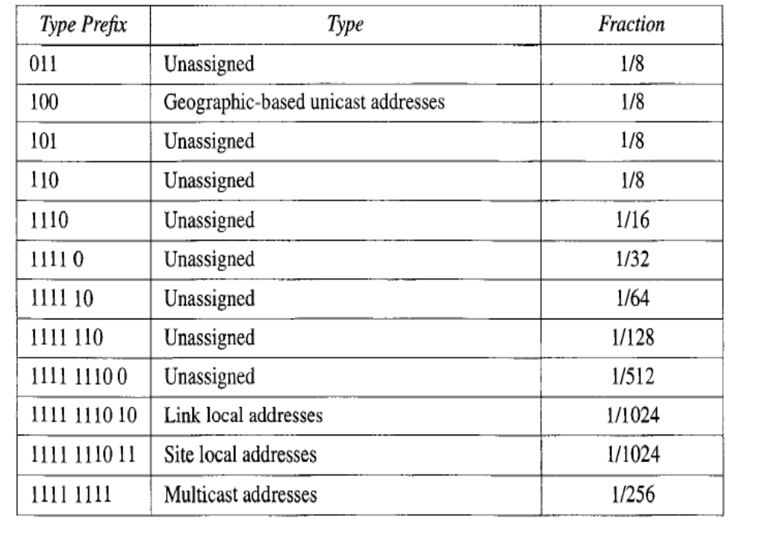
Type Prefix of IPv6

Slide 54
Unicast Addresses
A unicast address defines a single computer
The packet sent to a unicast address must be delivered to that specific computer
IPv6 defines two types of unicast addresses: geographically based and provider-based
  The first type is left for future definition.
  The provider-based address is generally used by a normal host as a unicast address

Slide 55
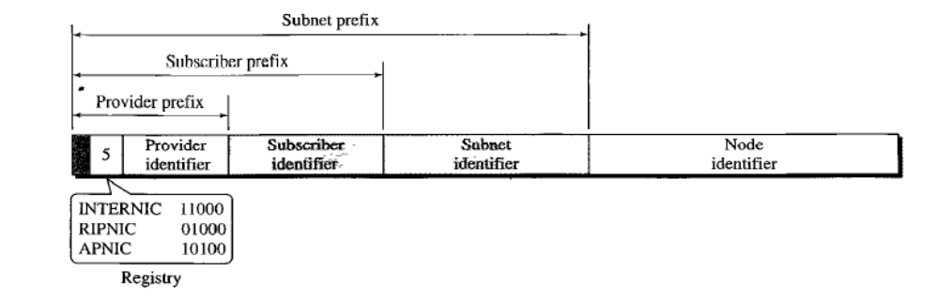
Prefixes for provider-based unicast address
Type identifier: This 3-bit field defines the address as a provider-based address.
Registry identifier: This 5-bit field indicates the agency that has registered the address.
Provider identifier: This variable-length field identifies the provider for Internet access (such as an ISP). A 16-bit length is recommended for this field.
.

Slide 56
Prefixes for provider-based unicast address..(Continued)
Subscriber identifier: When an organization subscribes to the Internet through a provider, it is assigned a subscriber identification. A 24-bit length is recommended for this field
Subnet identifier: The subnet identifier defines a specific subnetwork under the territory of the subscriber. A 32-bit length is recommended for this field.
Node identifier: The last field defines the identity of the node connected to a subnet(48bit MAC address is used)

Slide 57
Multicast Addresses
Multicast addresses are used to define a group of hosts instead of just one.
A packet sent to a multicast address must be delivered to each member of the group.

Slide 58
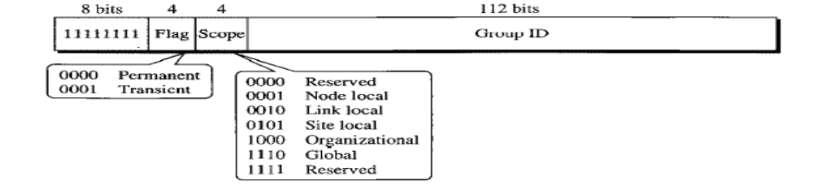
Multicast Addresses
The second field is a flag that defines the group address as either permanent or transient:
        A permanent group address is defined by the Internet authorities and can be accessed at all times
        A transient group address is used temporarily.
The third field defines the scope of the group address.

Slide 59
Anycast Address
An anycast address, like a multicast address, also defines a group of nodes.
A packet destined for an anycast address is delivered to only one of the members of the anycast group, the nearest one
One possible use is to assign an anycast address to all routers of an ISP that covers a large logical area in the Internet
The routers outside the ISP deliver a packet destined for the ISP to the nearest ISP router.

Slide 60
Reserved Addresses
These addresses start with eight 0s (type prefix is 00000000)
An unspecified address is used when a host does not know its own address and sends an inquiry to find its address
A loopback address is used by a host to test itself
A compatible address is used during the IPv4 to IPv6 transition (Used when IPv4 is still working along with IPv6)
A mapped address is also used during transition (Normally during migration, such that it works with IPv4 as backward compatible)

Slide 61
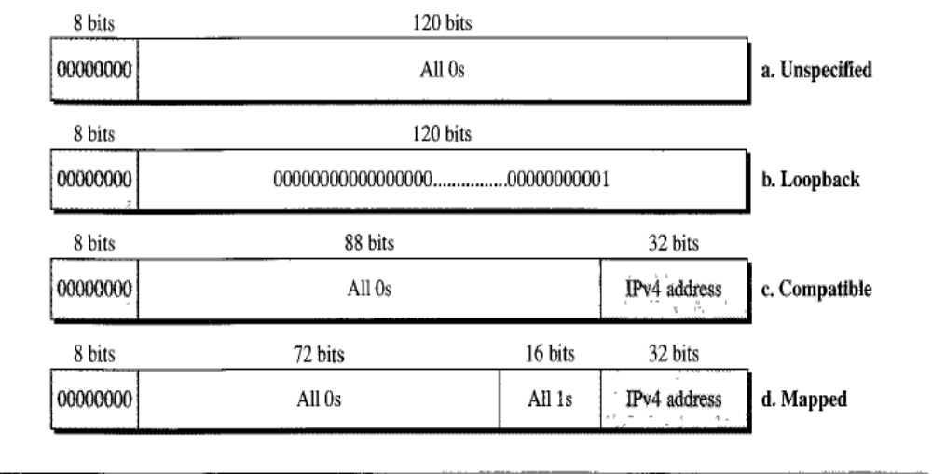
Reserved Addresses in IPv6

Slide 62
Local Addresses
used when an organization wants to use IPv6 protocol without being connected to the global Internet
They provide addressing for private networks.
A link local address is used in an isolated subnet;
A site local address is used in an isolated site with several subnets.

Slide 63
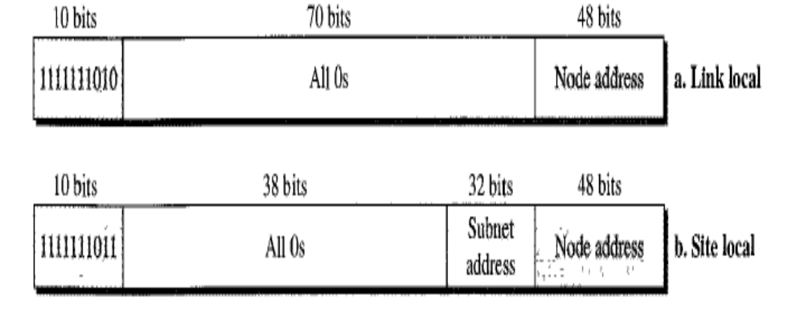
Local addresses in IPv6

